Slide 1
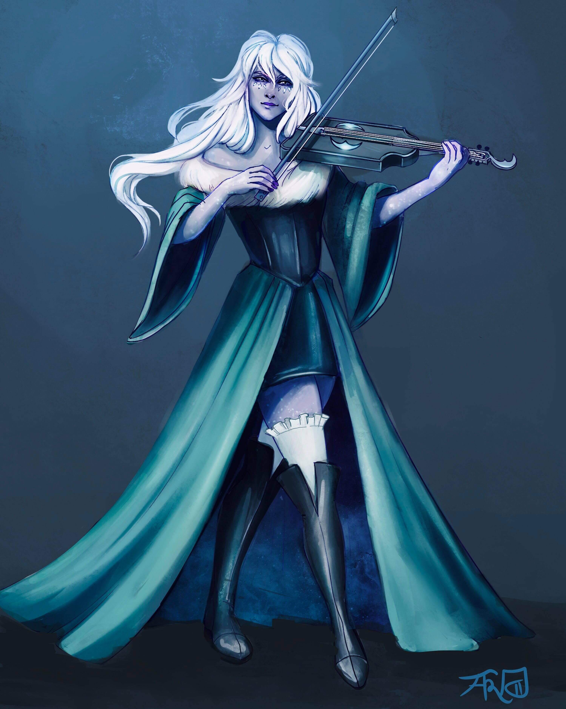
Bethany de Bolbec
Half Elf
Assistant at the Day Dream Library
Loves to play Viola and wants to prove her worth by joining the Flatcoat Circus.
Currently in a relationship with Desparia.
MISSING
Notes:
1 - Bethany
2 - Penguin
3 - Whistle
4 - Marbl
5 - Beverly
6 - Sunseer
7- Ramora
8 - Godvia
9 - Kyle
10 - Swan
11 - Luanda
12 - Rhino

Slide 2
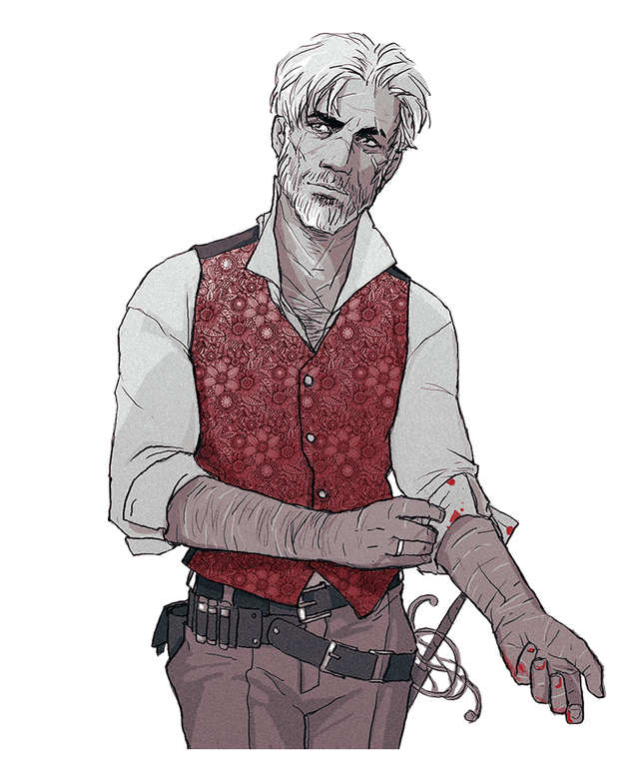
Penguin Varaati/???
Half-Elf
Adopted brother of Rhino’s Family
Very protective over Rhino, and “good” at calming him down.
Warlock gaining power from the left hand to Verrona’s God.
Having some personal time to think over the experience he had with Rhino.
Level 3 - Warlock
STR | DEX | CON | INT | WIS | CHA
11 (+0) | 18 (+4) | 12 (+1) | 17 (+3) | 12 (+1) | 19 (+4)
Notes:
1 - Bethany
2 - Penguin
3 - Whistle
4 - Marbl
5 - Beverly
6 - Sunseer
7- Ramora
8 - Godvia
9 - Kyle
10 - Swan
11 - Luanda
12 - Rhino

Slide 3
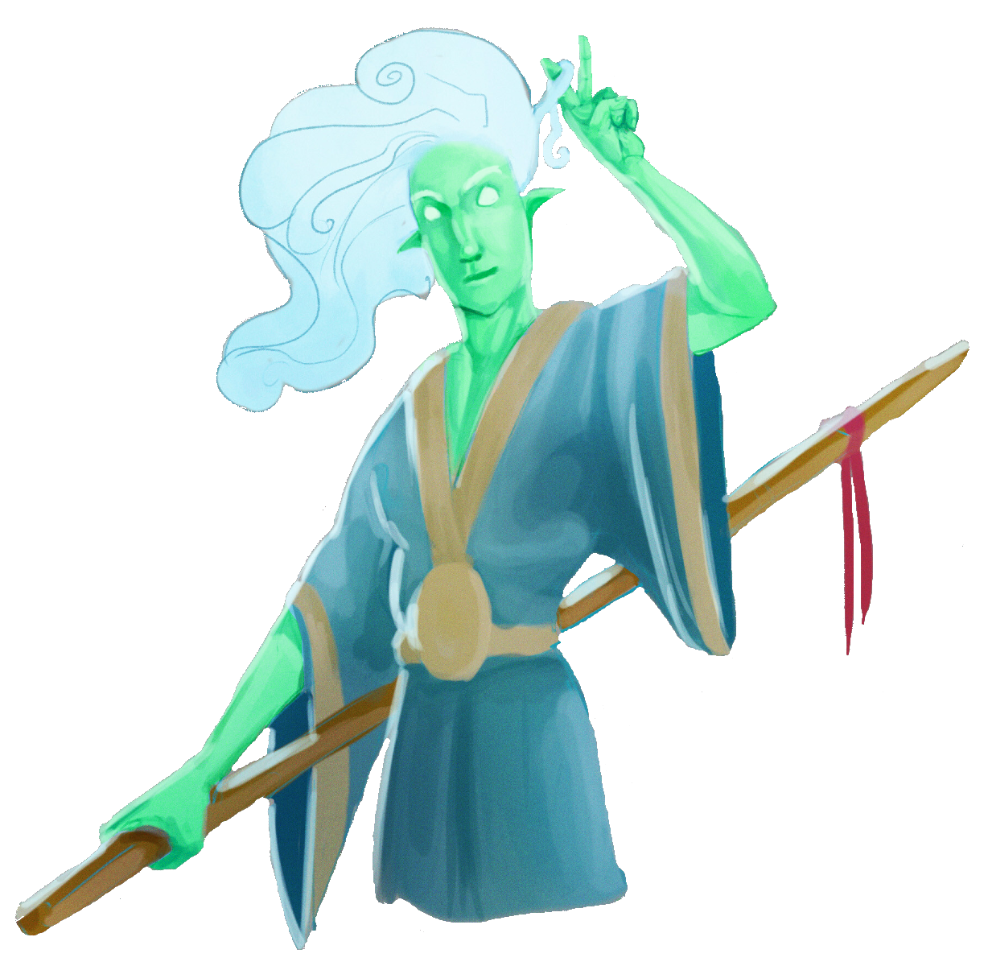
Whistle
Wind Genasi
Met at the White Basin Hotel
Adventuring with Marble
Fought off Rampaging Rhino.
Slightly upset from the attempt to deceive them and Marble.
Level 3 - Rogue
STR | DEX | CON | INT | WIS | CHA
10 (+0) | 14 (+2) | 14 (+2) | 11 (+0) | 11 (+0) | 12 (+1)
Notes:
1 - Bethany
2 - Penguin
3 - Whistle
4 - Marbl
5 - Beverly
6 - Sunseer
7- Ramora
8 - Godvia
9 - Kyle
10 - Swan
11 - Luanda
12 - Rhino

Slide 4
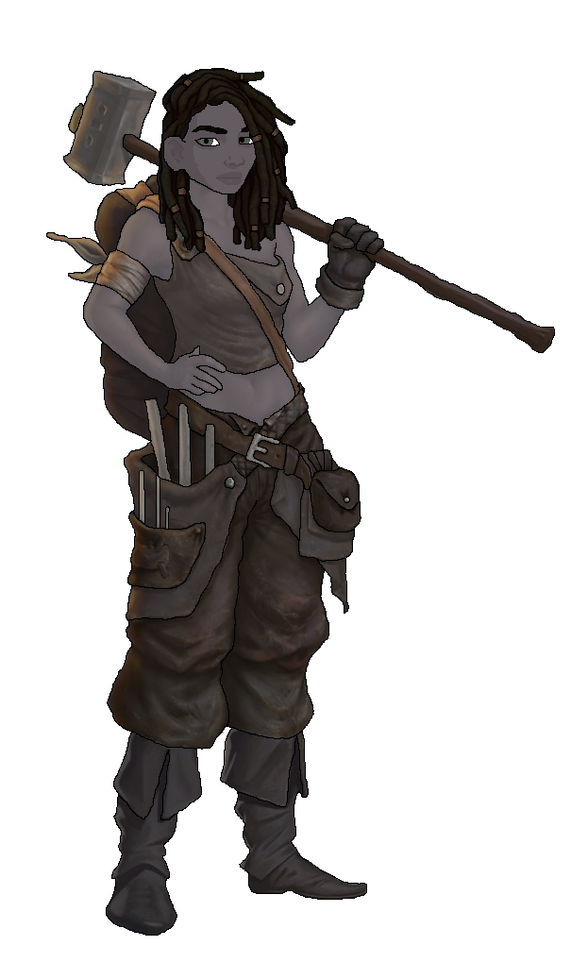
Marble
Earth Genasi
Met at the White Basin Hotel
Adventuring with Whistle.
Fought off Rampaging Rhino.
Grippers out- no boots.
Slightly upset from the attempt to deceive her and Whistle.
Level 3 - Fighter
STR | DEX | CON | INT | WIS | CHA
16 (+3) | 13 (+1) | 17 (+3) | 11 (+0) | 6 (-2) | 12 (+1)
Notes:
1 - Bethany
2 - Penguin
3 - Whistle
4 - Marbl
5 - Beverly
6 - Sunseer
7- Ramora
8 - Godvia
9 - Kyle
10 - Swan
11 - Luanda
12 - Rhino

Slide 5
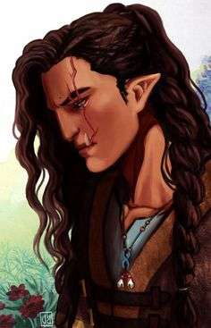
Beverly Caskbow
Half Orc
Owner of the Flowing Hammer
Got her scar from the Helmfield Cave
Joined you in the Helmfield Cave.
Scared to go out on more adventures and is comfortable working as a blacksmith.
Happy to help The Order of the Orb with whatever she can
Level 3 - Barbarian
STR | DEX | CON | INT | WIS | CHA
19 (+4) | 8 (-1) | 19 (+4) | 7 (-2) | 7 (-2) | 10 (+0)
Notes:
1 - Bethany
2 - Penguin
3 - Whistle
4 - Marbl
5 - Beverly
6 - Sunseer
7- Ramora
8 - Godvia
9 - Kyle
10 - Swan
11 - Luanda
12 - Rhino

Slide 6
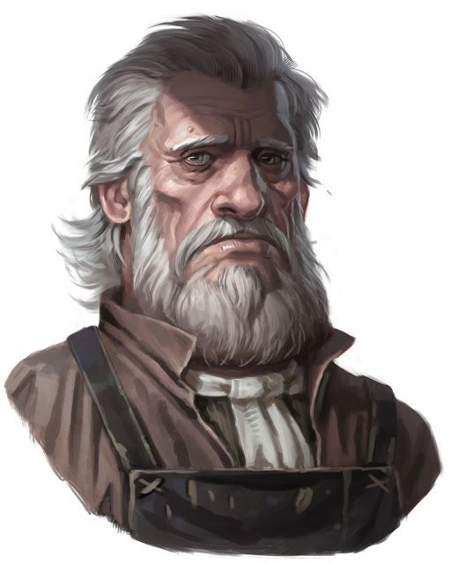
Sunseer Leonhard
Human
Owner of the White Basin Hotel
Upset due to the loss of his lovely wife but wants to try and move on.
Has positive and negative interactions with Hydrangea
Notes:
1 - Bethany
2 - Penguin
3 - Whistle
4 - Marbl
5 - Beverly
6 - Sunseer
7- Ramora
8 - Godvia
9 - Kyle
10 - Swan
11 - Luanda
12 - Rhino

Slide 7
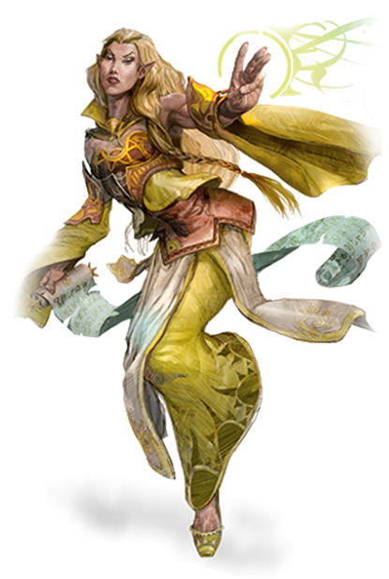
Ramora [Last Name UNKNOWN]
High Elf
Traveling Adventurer
Works Part-Time at the Day Dream Library
Extremely interested in any ancient artifact
Notes:
1 - Bethany
2 - Penguin
3 - Whistle
4 - Marbl
5 - Beverly
6 - Sunseer
7- Ramora
8 - Godvia
9 - Kyle
10 - Swan
11 - Luanda
12 - Rhino

Slide 8
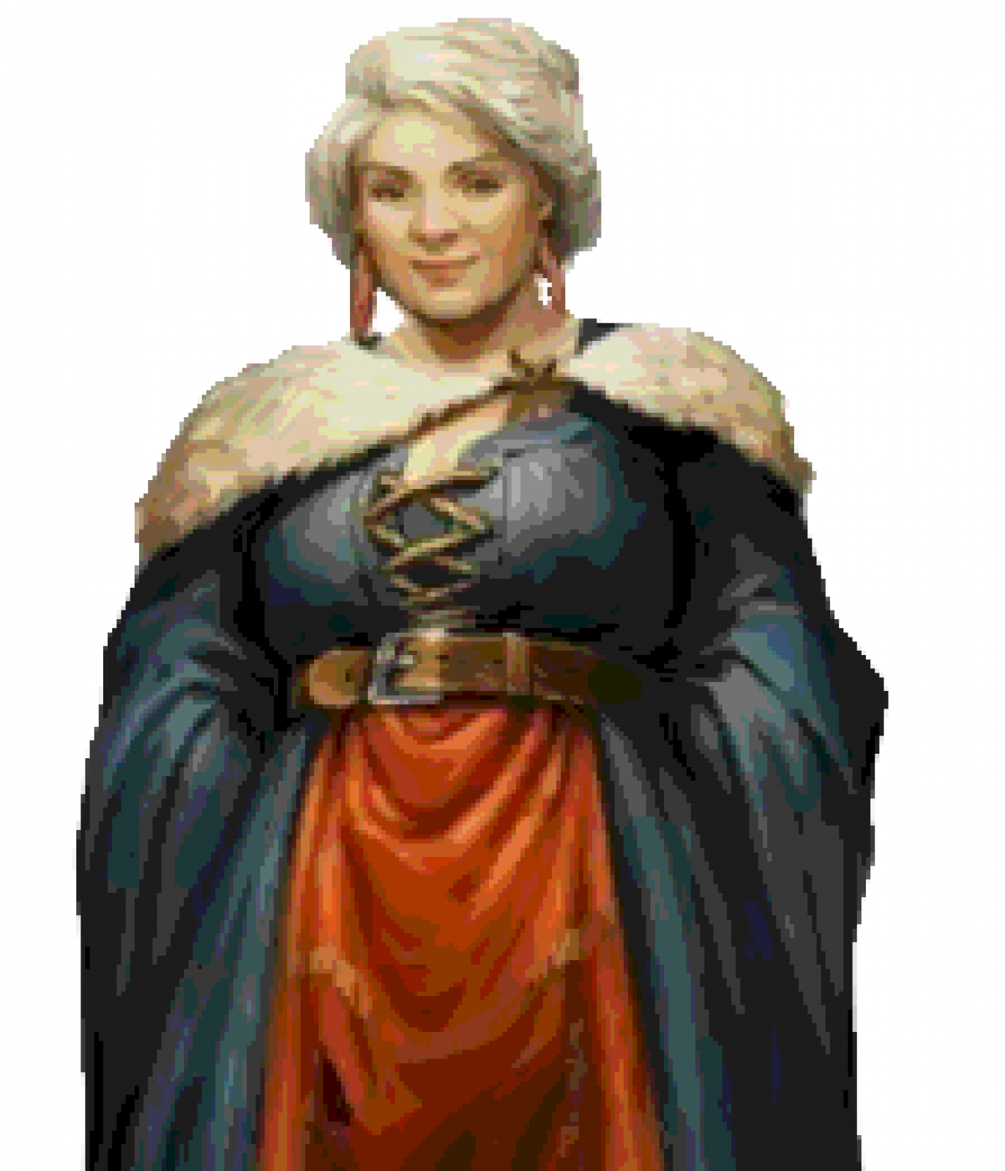
Godvia Commonbrook
Mayor of Helmfield
Her motto: “The people are first, the government is corrupt and make everyone happy!”
Notes:
1 - Bethany
2 - Penguin
3 - Whistle
4 - Marbl
5 - Beverly
6 - Sunseer
7- Ramora
8 - Godvia
9 - Kyle
10 - Swan
11 - Luanda
12 - Rhino

Slide 9
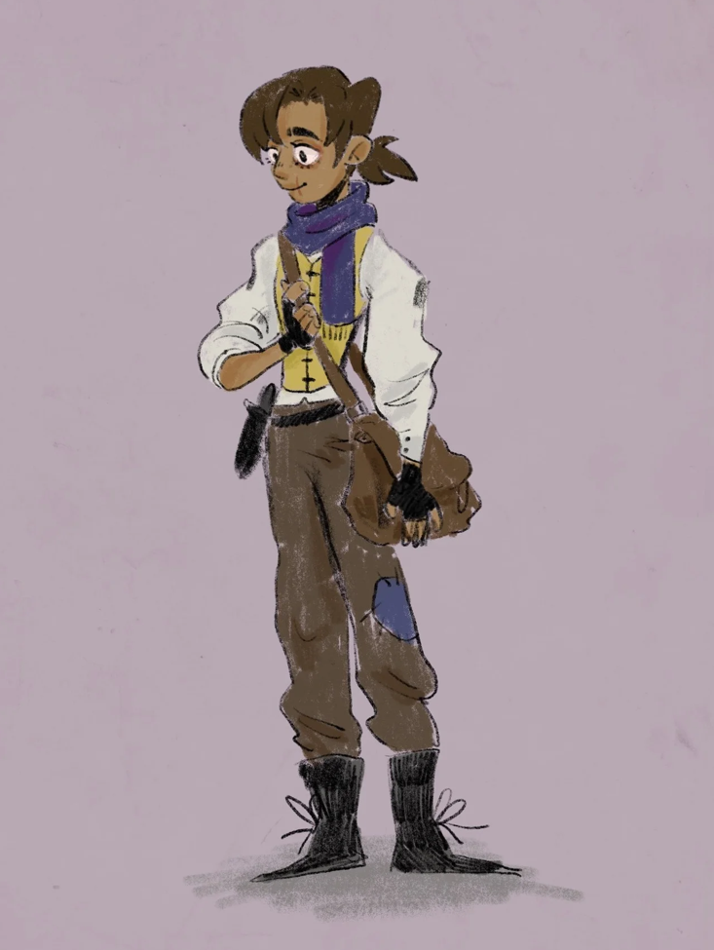
Kyle ???
Beat Rhino in Arm Wrestling due to the help of the party.
Is scared of Rhino.
Has Third Degree Burns on his right arm to his chin.
Notes:
1 - Bethany
2 - Penguin
3 - Whistle
4 - Marbl
5 - Beverly
6 - Sunseer
7- Ramora
8 - Godvia
9 - Kyle
10 - Swan
11 - Luanda
12 - Rhino

Slide 10
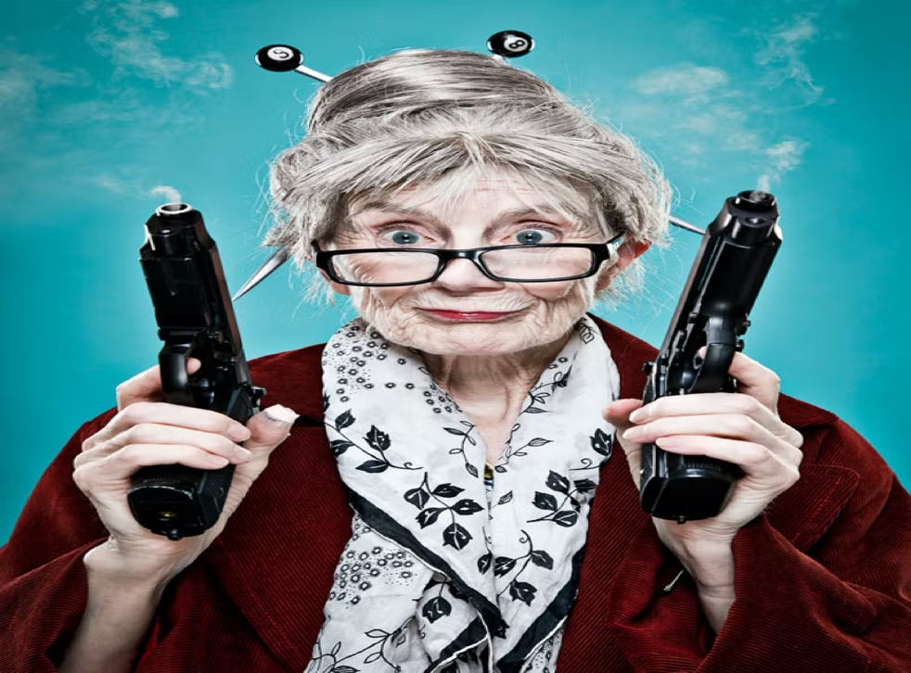
Swan [Last Name UNKNOWN]
Human
Owner of The Thoughtful Baker Bar
Extremely quick when getting drinks and food.
Notes:
1 - Bethany
2 - Penguin
3 - Whistle
4 - Marbl
5 - Beverly
6 - Sunseer
7- Ramora
8 - Godvia
9 - Kyle
10 - Swan
11 - Luanda
12 - Rhino

Slide 11
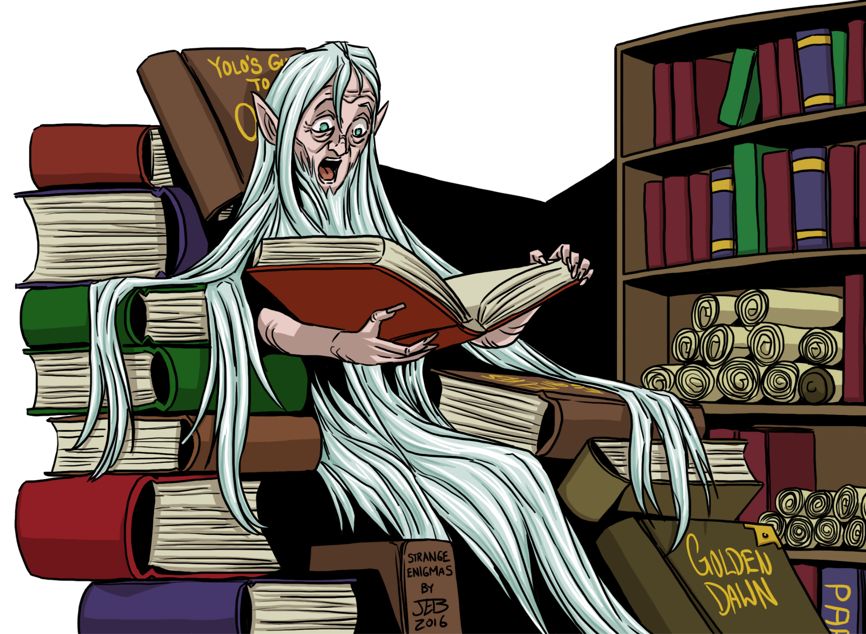
Luanda Hushbringer
Human
Owner of the Day Dream Library
Notes:
1 - Bethany
2 - Penguin
3 - Whistle
4 - Marbl
5 - Beverly
6 - Sunseer
7- Ramora
8 - Godvia
9 - Kyle
10 - Swan
11 - Luanda
12 - Rhino

Slide 12
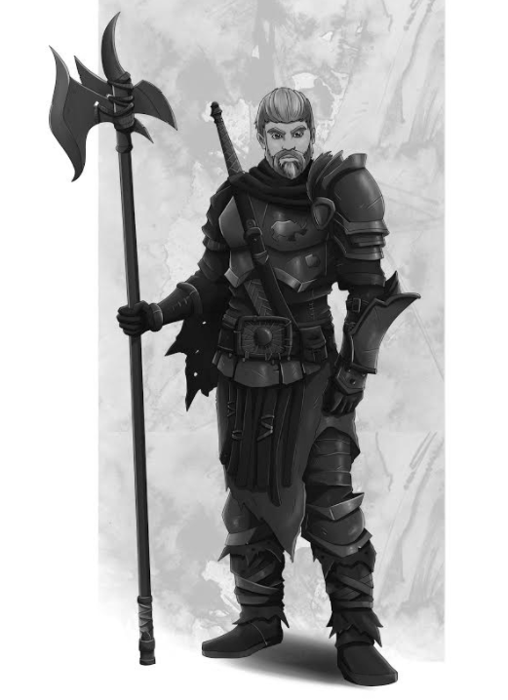
Rhino Varaati
Human
Ex-Arm Wrestling Champion of Helmfield
Depressed due to the current state of his life
Family took in Penguin as a child and raised him as their own.
Got crossed at the Party’s celebratory night and attacked Kyle while in a blind rage.
Died due to some unknown force and turning into ash.
DEAD
Notes:
1 - Bethany
2 - Penguin
3 - Whistle
4 - Marbl
5 - Beverly
6 - Sunseer
7- Ramora
8 - Godvia
9 - Kyle
10 - Swan
11 - Luanda
12 - Rhino

